Slide 1

SUICIDE ATTEMPT AND SUICIDE IDEATION

Slide 2
ABSTRACT
Suicidal behaviors, including Suicide attempts(SA) and Suicide ideation(SI) are complex and serious mental health issues that have a significant impact on individuals and society as a whole which require a multifaceted approach to prevention and treatment. Information related to patients’ previous and current SA and SI are frequently documented in EHR notes would help improve surveillance and predictions of patients’ behaviors and alert medical professionals for suicide prevention efforts.
Suicide Attempt and Ideation Events (ScAN) dataset, a subset of the publicly available MIMIC III dataset spanning over 12k+ EHR notes with 19k+ annotated SA and SI events information provides a strong baseline. There are a total of 17, 723 annotations for SA events and 1, 967 annotations for SI events.
ScANER (SA and SI retriever)consists of two sub-modules: (a.) an evidence retriever module that extracts all the relevant evidence paragraphs from the patient’s notes and (b.) a prediction module that evaluates the extracted evidence paragraphs and predicts the SA and SI event label. ScAN and ScANER could help extract suicidal behaviour in patients for suicide surveillance and predictions, leading to potentially early intervention and prevention efforts by medical professionals. The study will be performed in phases.

Slide 3
ABSTRACT
The first phase of study involves: (I)comparison of text classification techniques with the criteria: architecture, model, novelty, feature extraction, details, corpus, validation measure, and limitation of each technique. The evaluation of feature extraction approaches and existing classification algorithms such as Term frequency-Inverse document frequency(TF-IDF):SVM, bag of words:Boosting,Word2Vec and Global Vectors(GloVe):LSTM on the basis of precision ,recall, accuracy, Fβ, Matthew correlation coefficient (MCC), receiver operating characteristics (ROC), and area under curve (AUC) to measure effectiveness of text classifiers.(II) Critical limitations of each component of the text classification pipeline for implementing the best one. The second phase involves comprehensive study of transformer based language pre-trained models such as BERT,XLnet,RoberTa,GPT3,ELECTRA and ALBERT to provide a strong baseline model ScANER to extract all relevant suicidal behavioural evidences from EHR to identify type of suicidal behaviour. The proposed model is expected to learn two auxiliary tasks from the prediction module that uses paragraphs extracted by retriever module:(a.) Identifying the label for SA between positive, negative, unsure and neutral-SA and, (b.) Identifying the label for SI between positive, negative and neutral-SI.

Slide 4

LITERATURE SURVEY
FINDINGS:
The first phase of study involves: (I)comparison of text classification techniques with the criteria: architecture, model, novelty, feature extraction, details, corpus, validation measure, and limitation of each technique.
The evaluation of feature extraction approaches and existing classification algorithms such as Term frequency-Inverse document frequency(TF-IDF):SVM, bag of words:Boosting,Word2Vec and Global Vectors(GloVe):LSTM on the basis of precision ,recall, accuracy, Fβ, Matthew correlation coefficient (MCC), receiver operating characteristics (ROC), and area under curve (AUC) to measure effectiveness of text classifiers.

Slide 5
LITERATURE SURVEY
Critical limitations of each component of the text classification pipeline for implementing the best one. The second phase involves comprehensive study of transformer based language pre-trained models such as BERT,XLnet,RoberTa,GPT3,ELECTRA and ALBERT to provide a strong baseline model ScANER to extract all relevant suicidal behavioural evidences from EHR to identify type of suicidal behaviour.
The proposed model is expected to learn two auxiliary tasks from the prediction module that uses paragraphs extracted by retriever module:(a.) Identifying the label for SA between positive, negative, unsure and neutral-SA and, (b.) Identifying the label for SI between positive, negative and neutral-SI.
.

Slide 6
DATASET collection
We selected the notes from the MIMIC-III (Johnson et al., 2016) dataset, which consists of the de-identified EHR data of patients admitted to the Beth Israel Deaconess Medical Centre in Boston, Massachusetts from 2001 to 2012.
Data includes notes, diagnostic codes, medical history, demographics, lab measurements among many other record types.
We chose MIMIC-III because it is publicly avail- able under a data use agreement and allows clinical studies to be easily reproduced and compared.
The diagnostic ICD codes for the patients are provided at hospital-stay level in MIMIC with admission identification numbers (HADM_ID in MIMIC database).
For each stay, multiple de-identified notes such as nursing notes, physician notes, and discharge summaries are available.

Slide 7
DATASET collection
ScAN consists of 19, 690 unique evidence annotations for the suicide relevant sections of 12, 759 EHRs of 697 patient hospital-stays. There are a total of 17, 723 annotations for SA events and 1, 967 annotations for SI events.
The distribution for both SA and SI events is provided in Table 1.
Table 1: Distribution of unique annotations at the patient, hospital-stay and notes level
General Statistics | Patients 669 | Hospital-stays 697 | Notes 12, 759
Suicide Attempt | Positive 14, 815 | Negative 170 | Unsure 2, 738
Suicide Ideation | Positive 1,167 | Negative 800

Slide 8
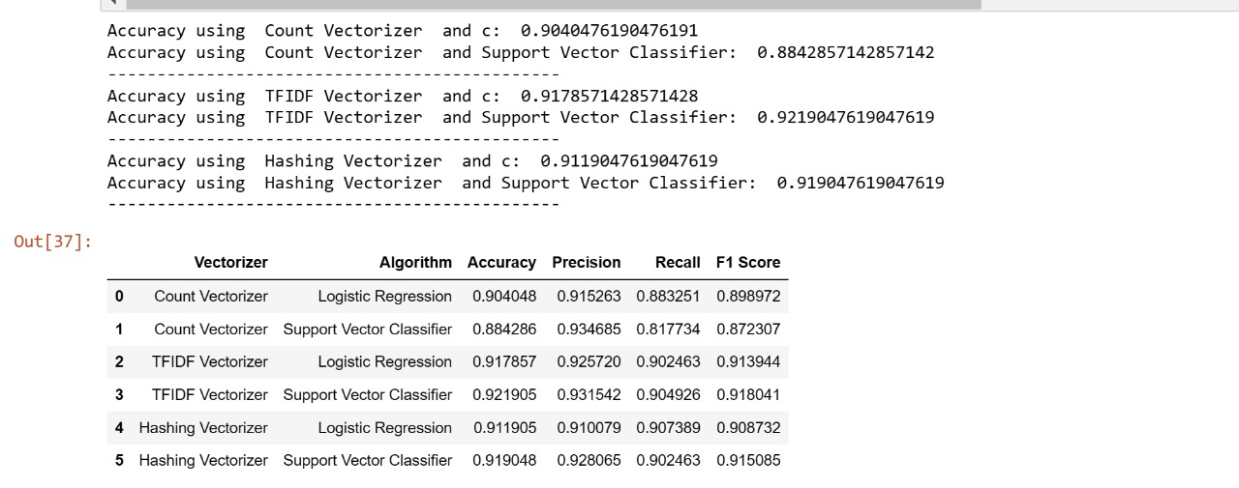
Implementation and results
NUS_RP #1.ipynb - Colaboratory (google.com)

Slide 9
THANK YOU

